Slide 1
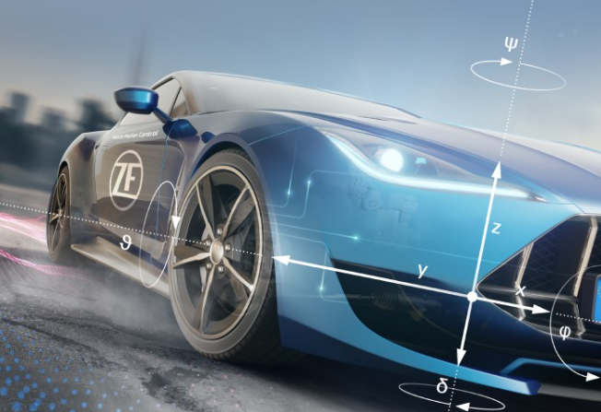
ZF LiftLoop
…Find the perfect ride you want
E-Rangers
Kasturi Manu EDEEF43
Kasarla Sathish EDEEF43
Pathi Girish EDEEF44

Slide 2
Contents
Introduction
Architecture
Ride post information
User Joining process
Unique Features

Slide 3
Introduction
ZF Liftloop
Enables employees to collaborate and coordinate their commutes to and from the office
Contributes to environmental sustainability by reducing CO2 emissions.
Built on ready stable platform MS Teams
Includes all recommended features

Slide 4
TCI Employee Commute
Architecture
Route - 1
Route - 2
Route - N
Riders
Passengers
Riders
Passengers
Riders
Passengers

Slide 5
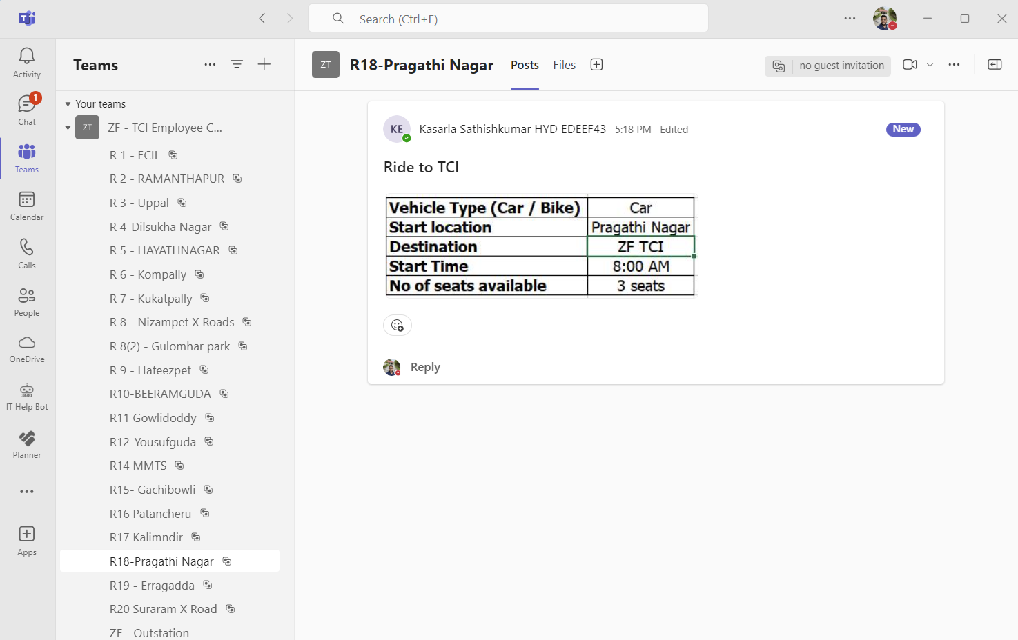
Ride Post information

Slide 6
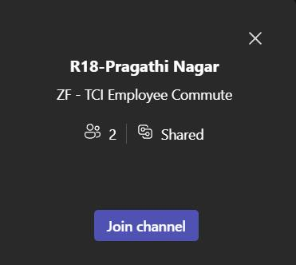
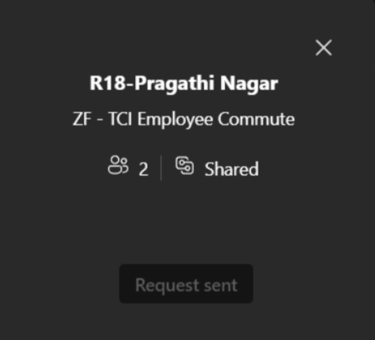
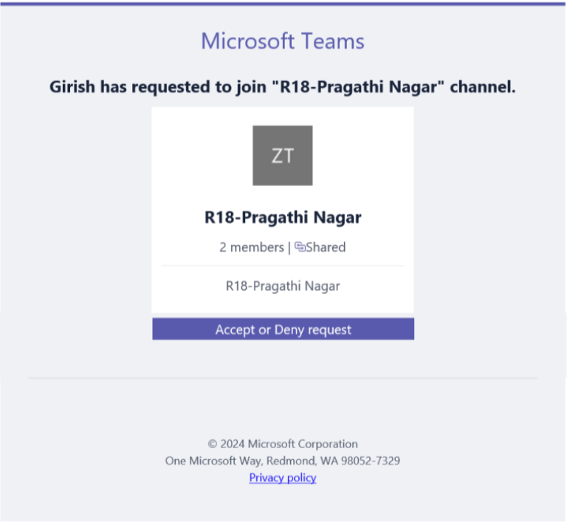
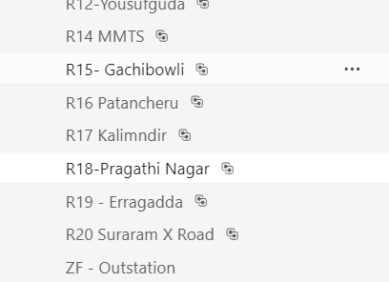
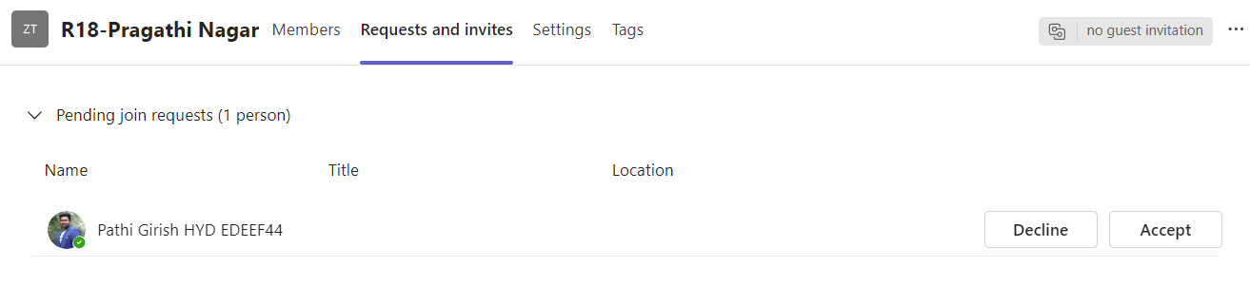
User Joining Process
Channel joining links can be shared to employees via corporate mail.
The relevant route channels can be joined by passengers
Route Link: ZF - TCI Employee Commute | R18-Pragathi Nagar | Microsoft Teams

Slide 7
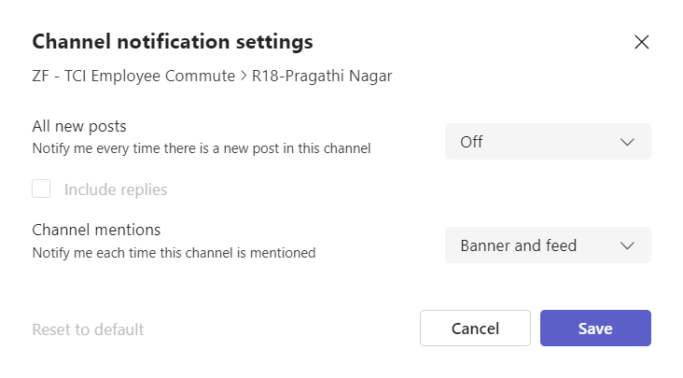
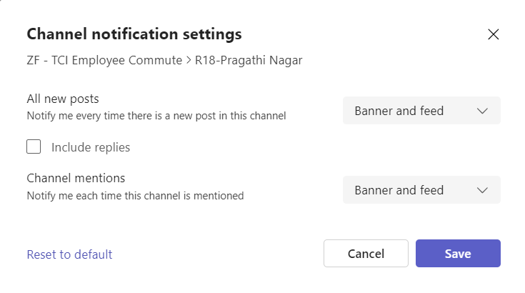
Relevant route notifications
Continued...

Slide 8
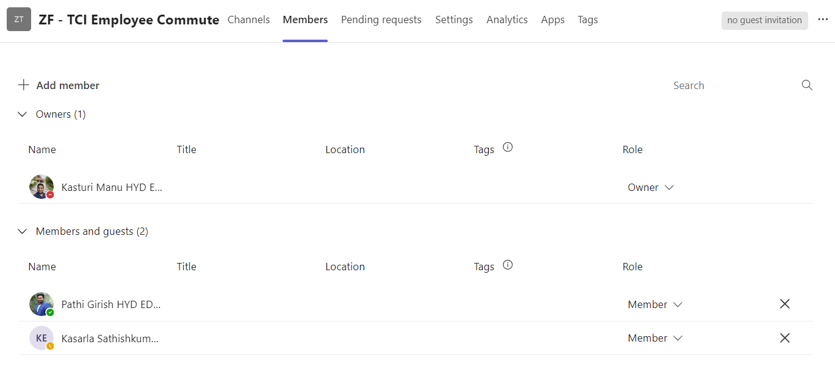
Roles
Admins
Ride Provider/ Passengers

Slide 9
Unique Features
No extra cost in terms of tool/app
Rare down time issues
Scalable quantity
Communication Friendly
Flexible to on/off relevant route alerts
More secure in terms of employee data & privacy
No server maintenance
No IT restrictions

Slide 10
Thank You!

